Slide 1
Hello Elixir!
Sameeri Marryboyina

Slide 2



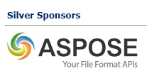
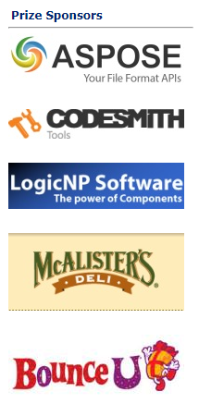


Thank you sponsors

Slide 3


Thank you TECHLAHOMA!
OKC Elixir
OKC FP
Find Techlahoma on all things social.

Slide 4

Talk Agenda
About Me
Target Audience
Foundations
The road to Elixir (How I met Elixir!)
Elixir

Slide 5
ABOUT ME

Slide 6
Hello, sameeri.
Sameeri Pavan Kumar Marryboyina
Hyderabad, India
I can communicate in Telugu, Hindi, English, German(very little)
MS in Computer Science, The University of Oklahoma
Senior Software Engineer, Telogical Systems LLC
Full Stack JS - React, Redux and its Ecosystem, Node, Express
Norman, OK

Slide 7
India
Let us travel to Sameeri’s home..
https://www.google.com/maps/place/India/@18.2937219,71.4458457,5z/data=!4m5!3m4!1s0x30635ff06b92b791:0xd78c4fa1854213a6!8m2!3d20.593684!4d78.96288

Slide 8
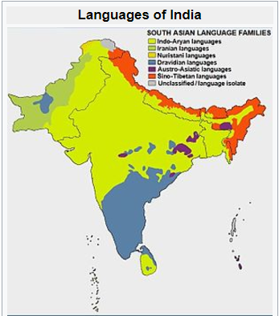
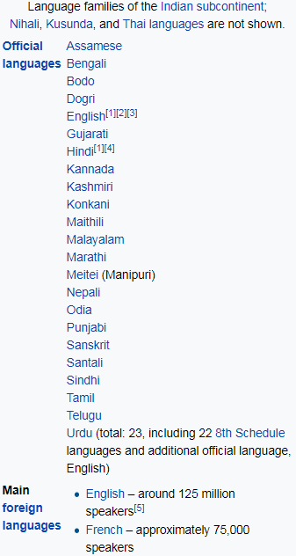
source : https://en.wikipedia.org/wiki/Languages_of_India

Slide 9
TARGET AUDIENCE

Slide 10
FOUNDATIONS

Slide 11
Being a polyglot...
WORK | SCHOOL | LEARNING | RADAR
JavaScript | C | Elixir | Elm
C# | C++/VC++ | Erlang | TypeScript
Ruby | COBOL |  | Python
Java | Assembly |  | Scala
 |  |  | Rust
 |  |  | Go

Slide 12
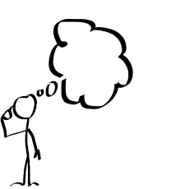
But, What does it mean to be a Language?

Slide 13
What kind of a problem are we trying to solve?
A language is a tool.
Problems and Contexts
We want to use the right tool for a given problem
Communication

Slide 14
A Language…
Alphabet
Constructs
Syntax
Semantics
Type System (Static vs Dynamic)
Translation Model (Compiled vs Interpreted)
Execution model
Runtime Mechanics
Specification
Implementation

Slide 15
Language tools
Editor
Compiler
REPL
Virtual Machine
Debugger
Standard Library
Dependency Management
Build tool
Workflow tools based on processes – Tests, Coverage, Syntax highlighting, Refactoring…

Slide 16
Inside the head of a software engineer
Language Syntax
Types
Philosophy
Paradigms
Standards/Best Practices
Principles
Patterns
Problem + Context
Crafting solutions

Slide 17
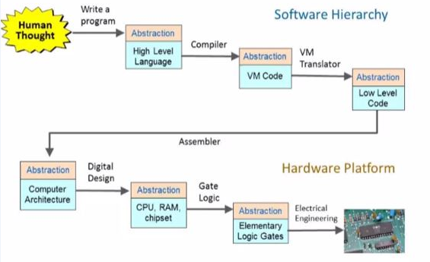
The process – From Human thought to something magical
source : http://www.nand2tetris.org/

Slide 18
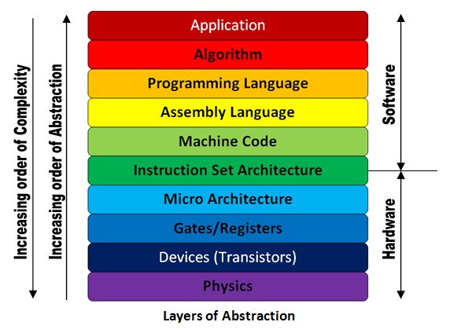
The Machine stack – Layers of Abstraction
source : http://theembeddedguy.com/2016/05/15/layers-of-abstraction/

Slide 19
Language translation
TRANSLATOR
SOURCE
LANGUAGE
TARGET LANGUAGE
Based on the language, its philosophy, the translator could be called anything. Say, compiler for instance.
A very important observation to make in the context of language translation is whether we can observe the
Generation of an intermediary file or not. This also defines the execution/runtime mechanics.

Slide 20
Modern languages
Roughly after 1985.
Memory should be managed automatically. aka Garbage Collection
Provision of higher level abstraction constructs.
The concept of a runtime, intermediary language => Virtual Machine
Developers Psychology - Discovery of patterns and anti patterns, How to write good/clean code?

Slide 21
VIRTUAL MACHINES
Source
Portability
The notion of Intermediary Language
Multiple Languages targeting the VM.
Defines execution semantics
Intermediary
Translation process
VIRTUAL MACHINE

Slide 22
Familiar virtual machines
Java World : Java Virtual Machine (JVM)
.NET World: Common Language Runtime (CLR)

Slide 23
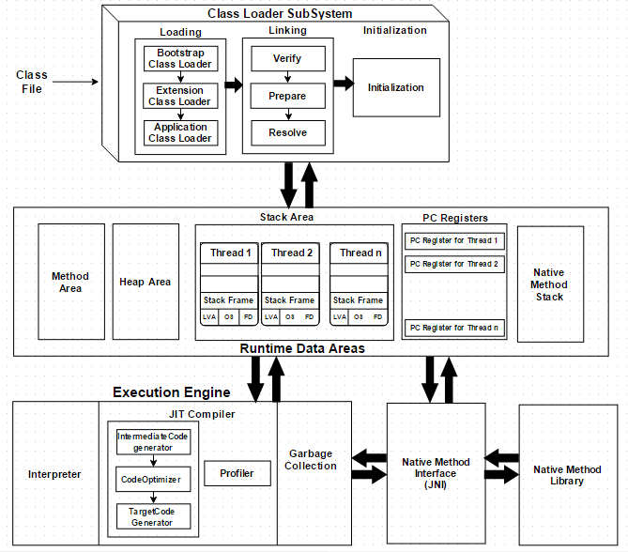
JVM

Slide 24
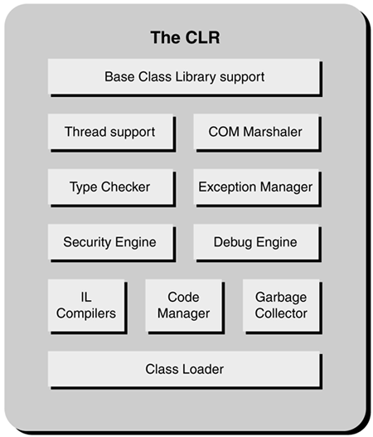
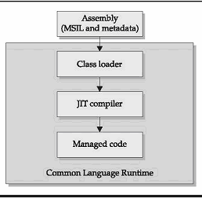
CLR

Slide 25
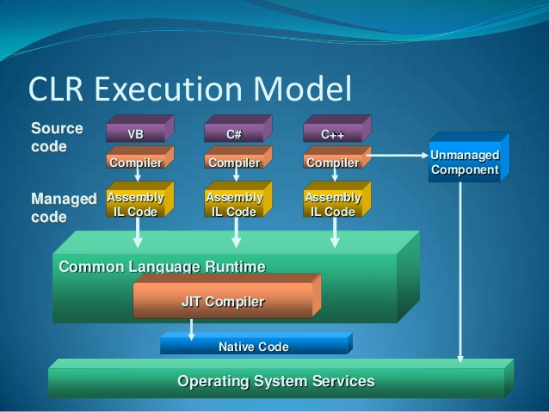
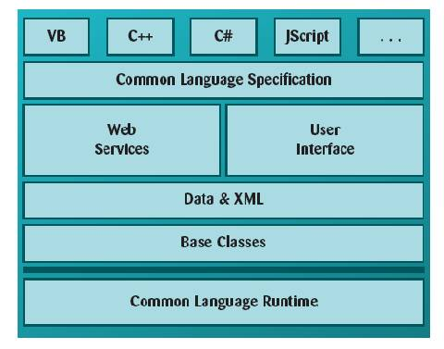
The power of an intermediary language & VM
Multiple languages can now target the intermediary language. They can also all use the
Services that the runtime has to offer. A high degree of reusability.

Slide 26
Where does the OS FIT IN?
VM/Runtime is all good.
But…
The fundamental way to run a program is via the OS.
All hail the OS!!

Slide 27
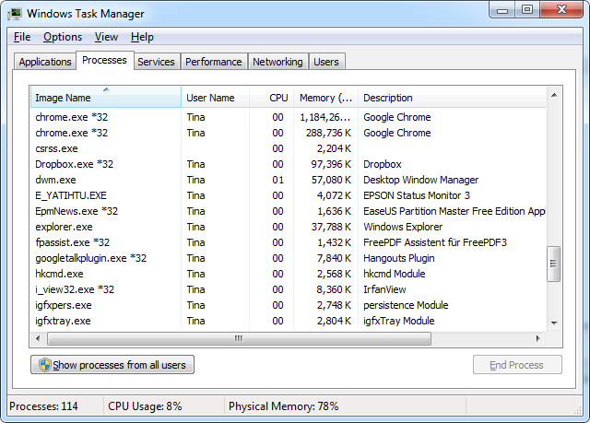
Operating system constructs
Process
Thread
Concurrency
Context Switching
Schedulers
Scheduling Algorithms
The user is tricked. But that is good.
Everyone loves Magic!

Slide 28
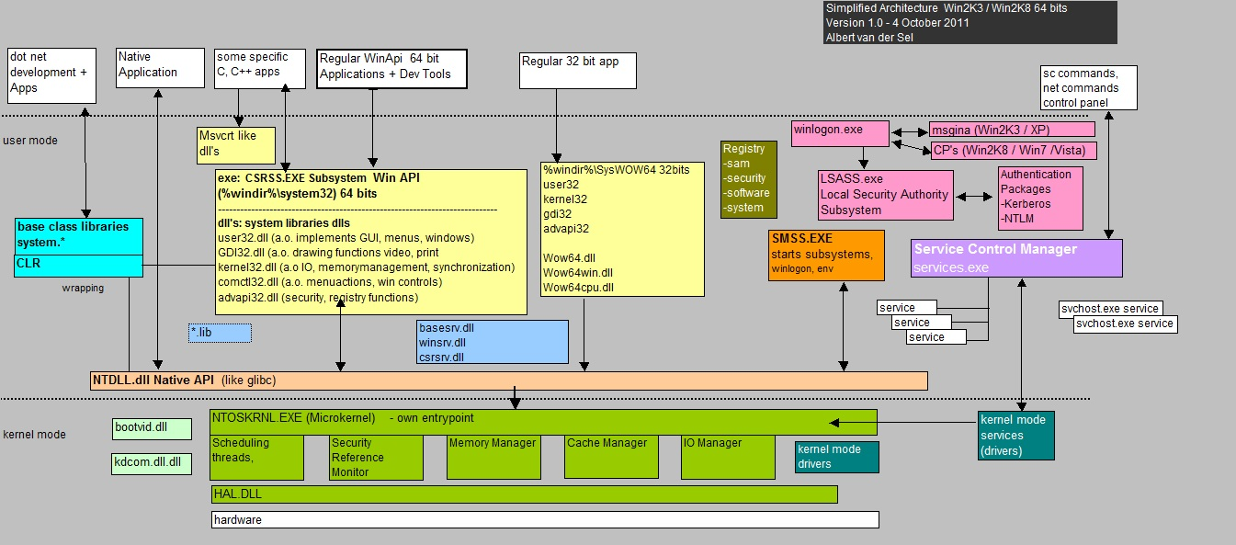
Operating system OPERATION

Slide 29
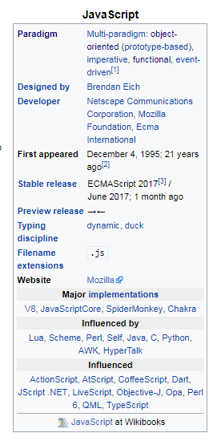
How languages s each other
Languages influence one another.
That means language designers(people) are constantly trying to improve the language
They do this by exploring other languages/environments trying to find good ideas and bring them aboard.

Slide 30
Thoughts on languages
I consider language as a tool, method to communicate our thoughts.
Since it is a tool, it is a matter of preference.
But, People are highly opinionated.
People are programmed to think in one way, when they are in one environment.
If we step out, we will find commonalities and find love for the language.
Studying a lot of languages help us grow and think better.
Languages are mostly multi-paradigm. That means we have a lot of thinking hats to put on and find the best way to solve a problem.
We should continuously discover and enjoy
Tooling is very important to build products quickly.
Tooling has a “happy developer factor” associated with it.
We should invest time in learning and learning is continuous.
We should try to craft clean code.

Slide 31

The road to elixir…

Slide 32
Core LEARNING interests
Distributed Systems
Event Oriented Architecture
Message Oriented sytems
Highly scalable systems
Reactive Architectures
“All the vocabulary is great! How should we learn these? What’s the plan?” I said to myself.

Slide 33
The bus
Service Bus
Enterprise Service Bus
Message Bus
I encountered a lot of terms.
I worked on NServiceBus in my .NET days!

Slide 34
What does it mean to be a distributed system?
The 8 Fallacies of Distributed Computing
https://en.wikipedia.org/wiki/Fallacies_of_distributed_computing
Networks
Interprocess communication
Communication, Collaboration, Coordination.
Application integration

Slide 35
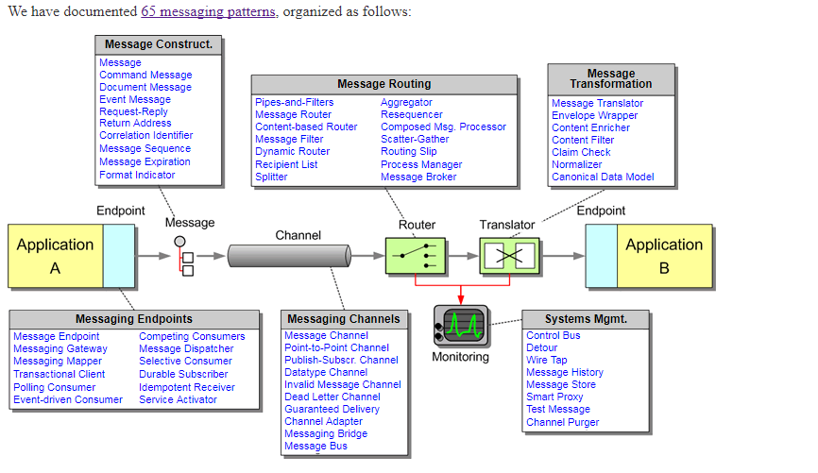
Integration patterns
http://www.enterpriseintegrationpatterns.com/patterns/messaging/

Slide 36

RABBITMQ ADVENTURES
AMQP
RabbitMQ history
RabbitMQ Constructs
RabbitMQ examples/patterns
https://www.rabbitmq.com/getstarted.html

Slide 37
ERLANG

